Slide 1

MIS 6363-Cloud Computing Fundamentals
Engin Calisir MS, MBA

Slide 2
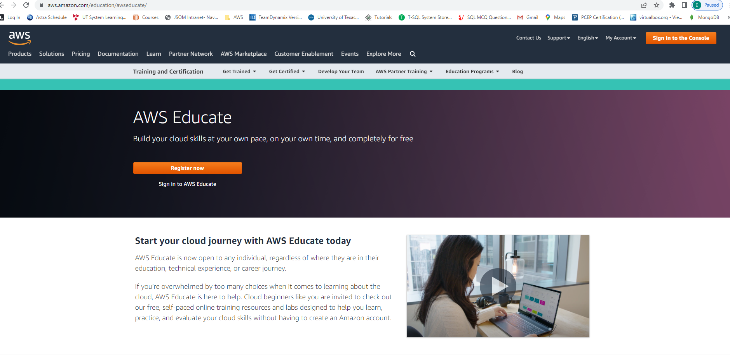
Labs

Slide 3
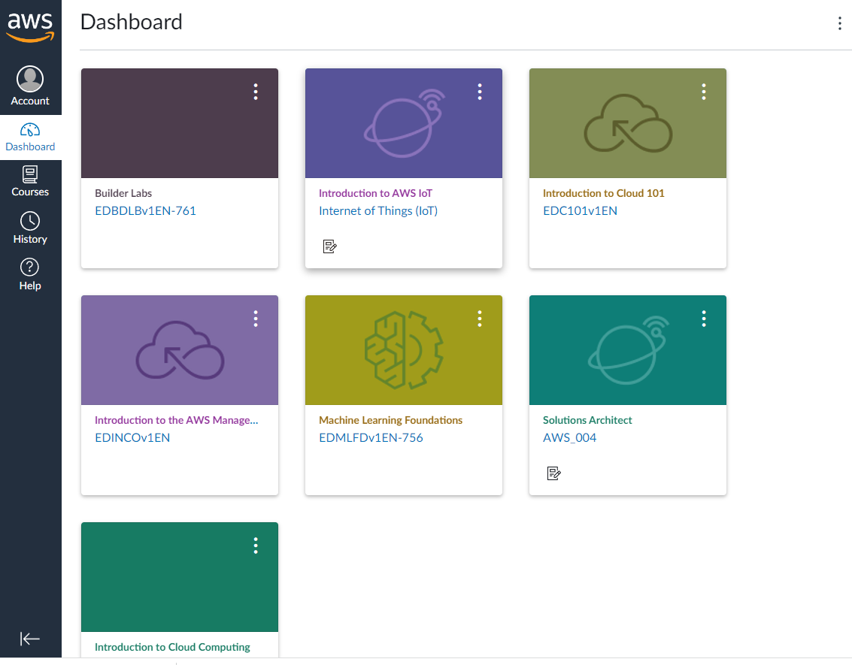
Labs

Slide 4
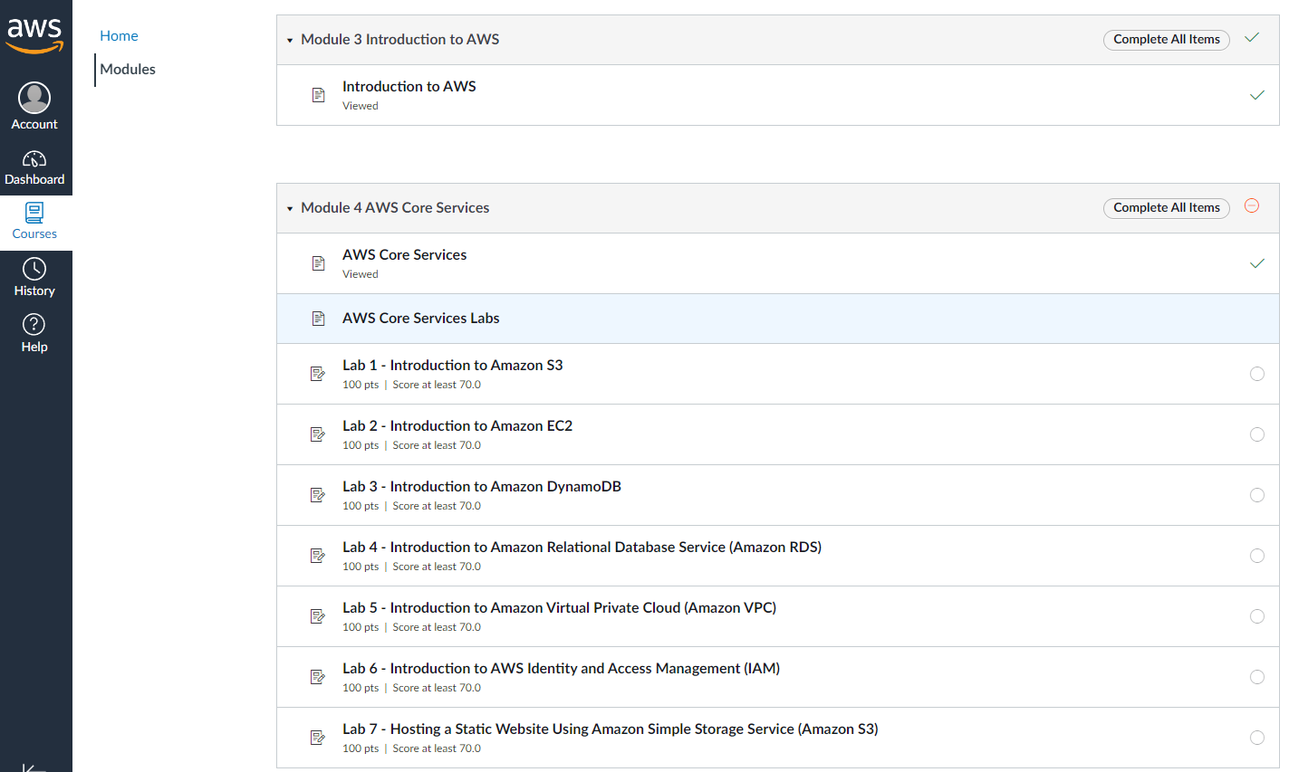
Labs

Slide 5
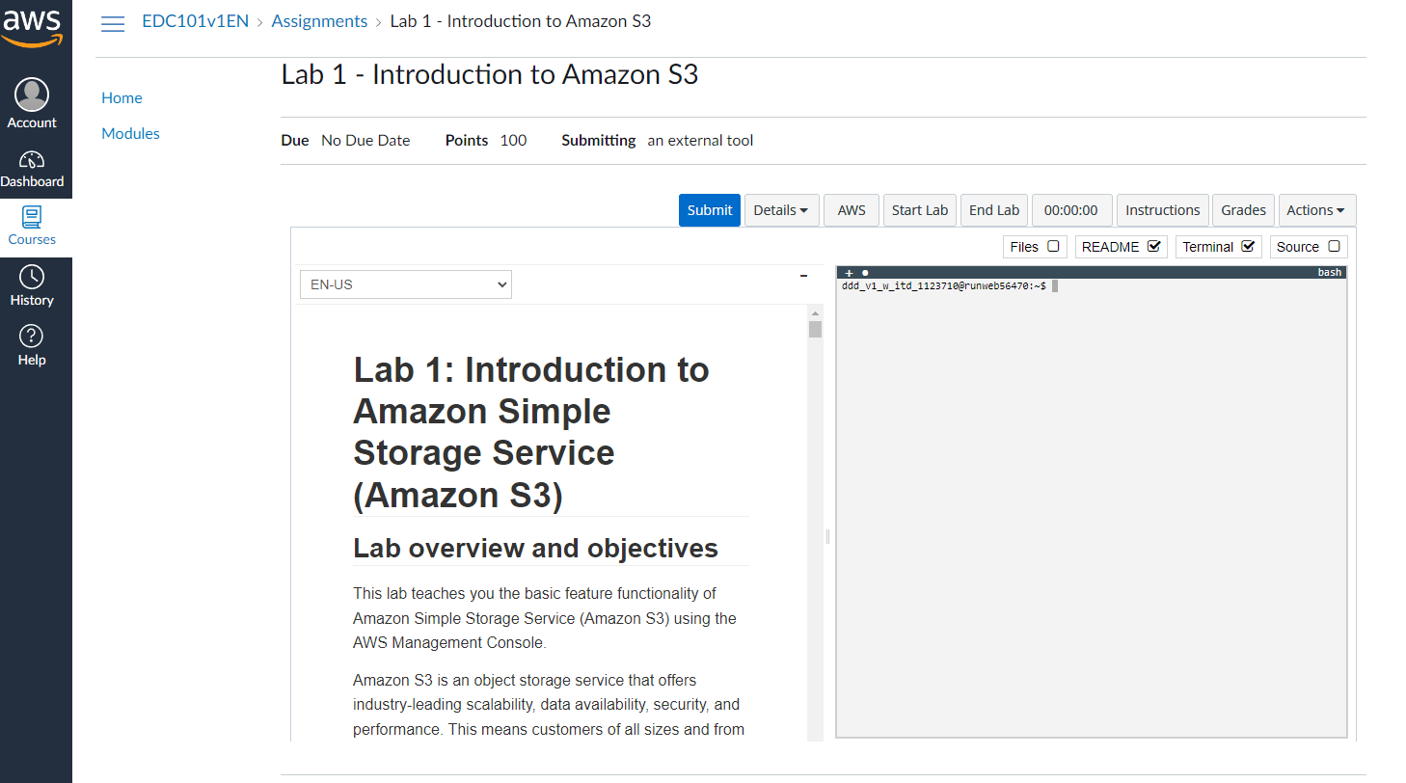
Labs

Slide 6
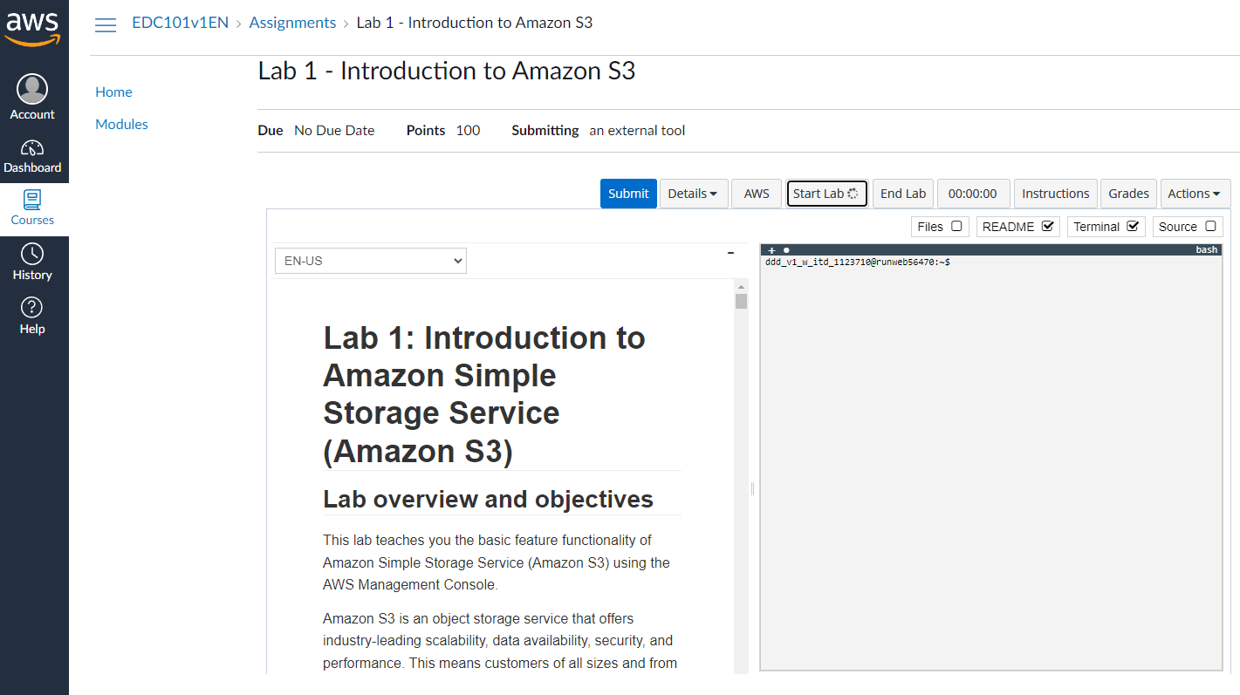
Labs

Slide 7
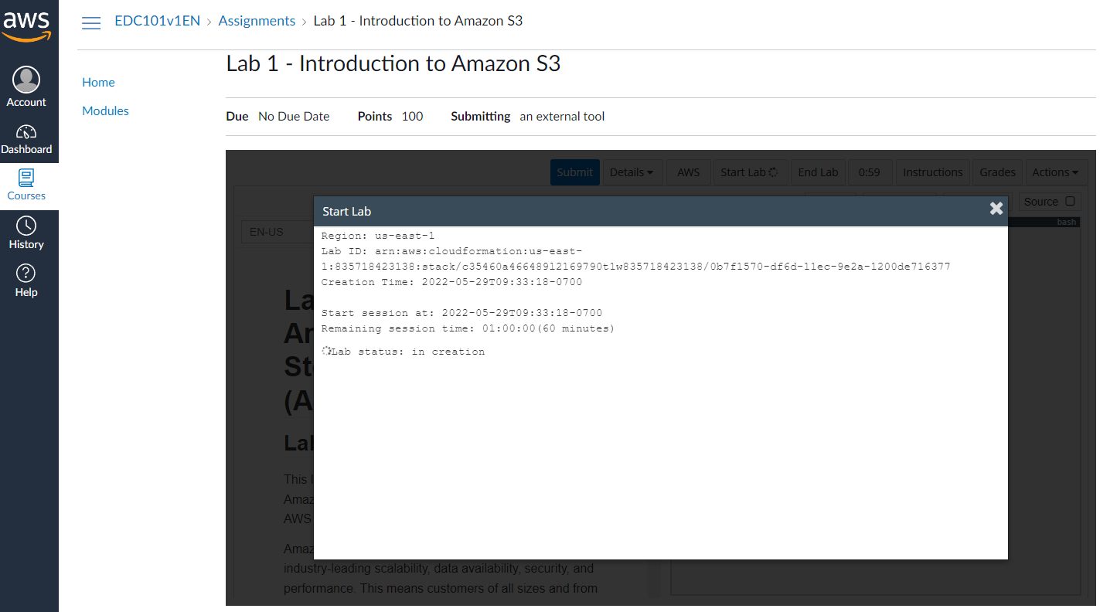
Labs

Slide 8
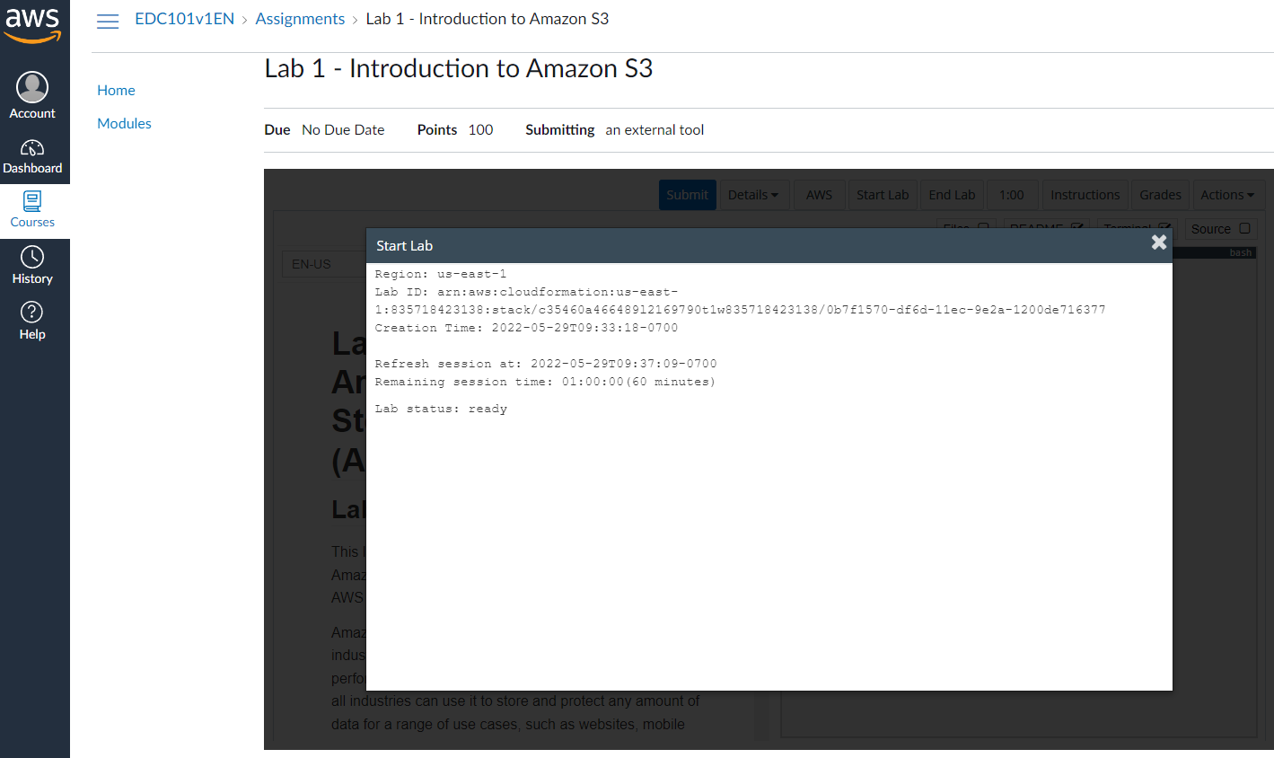
Labs

Slide 9
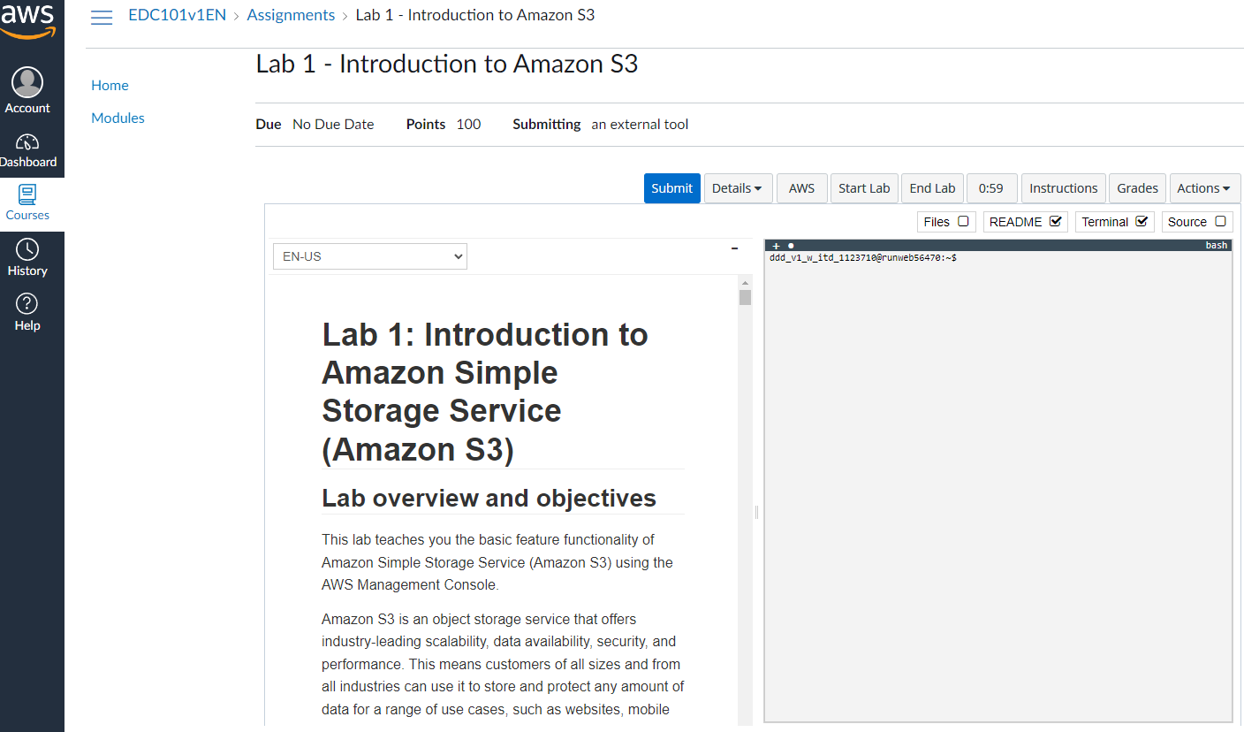
Labs

Slide 10
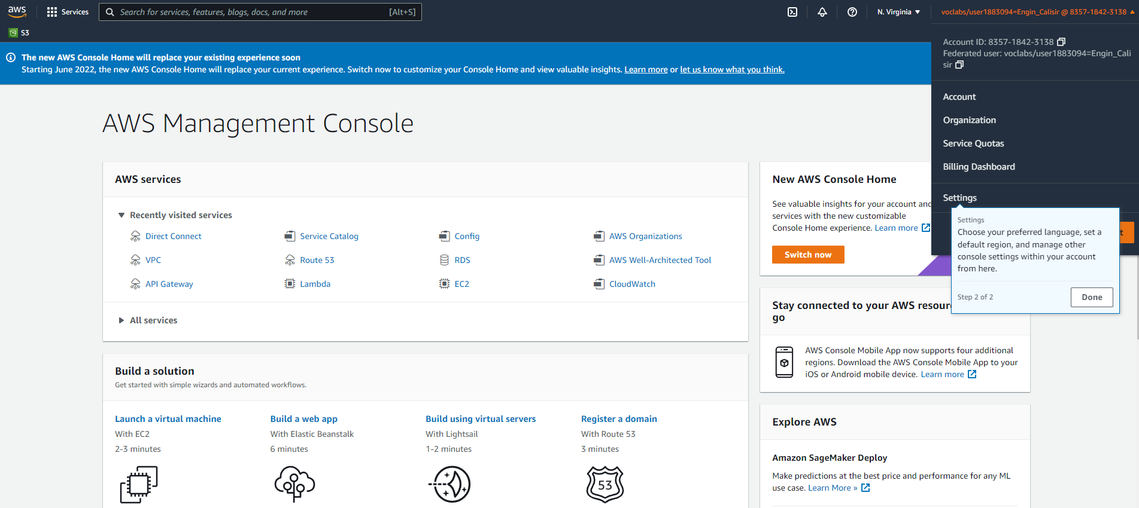
Labs

Slide 11
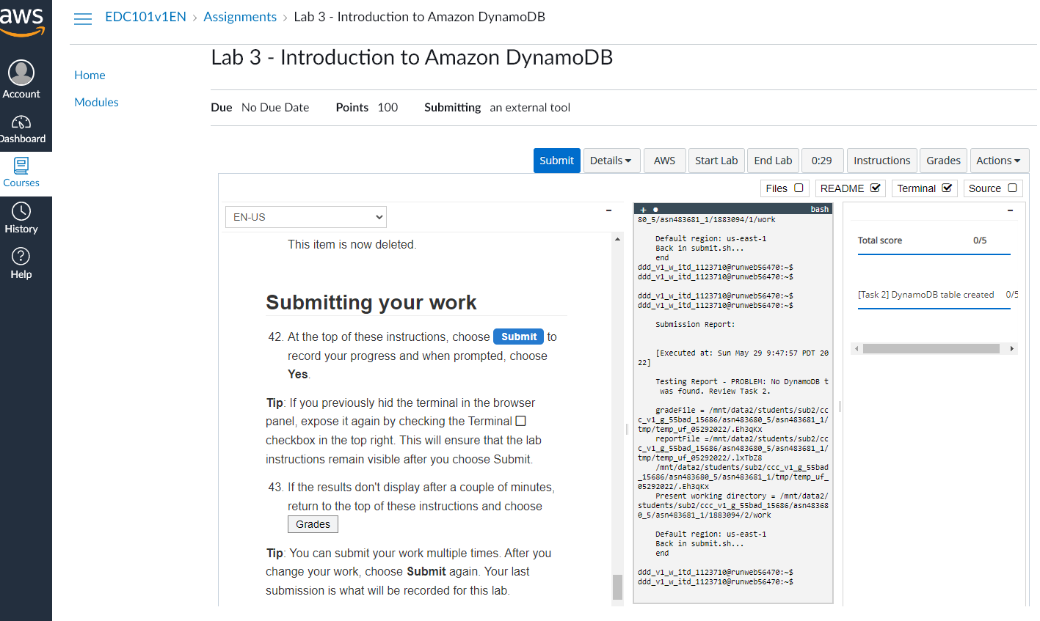
Submitting your work for grade

Slide 12
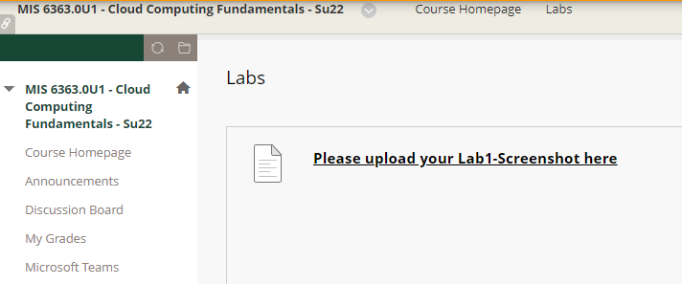
Uploading your final screenshot
Step1: Take your whole screenshot
Step2: Save it as a pdf file
Step3: Upload the file into UTD e-learning

Slide 13
Labs

Slide 14
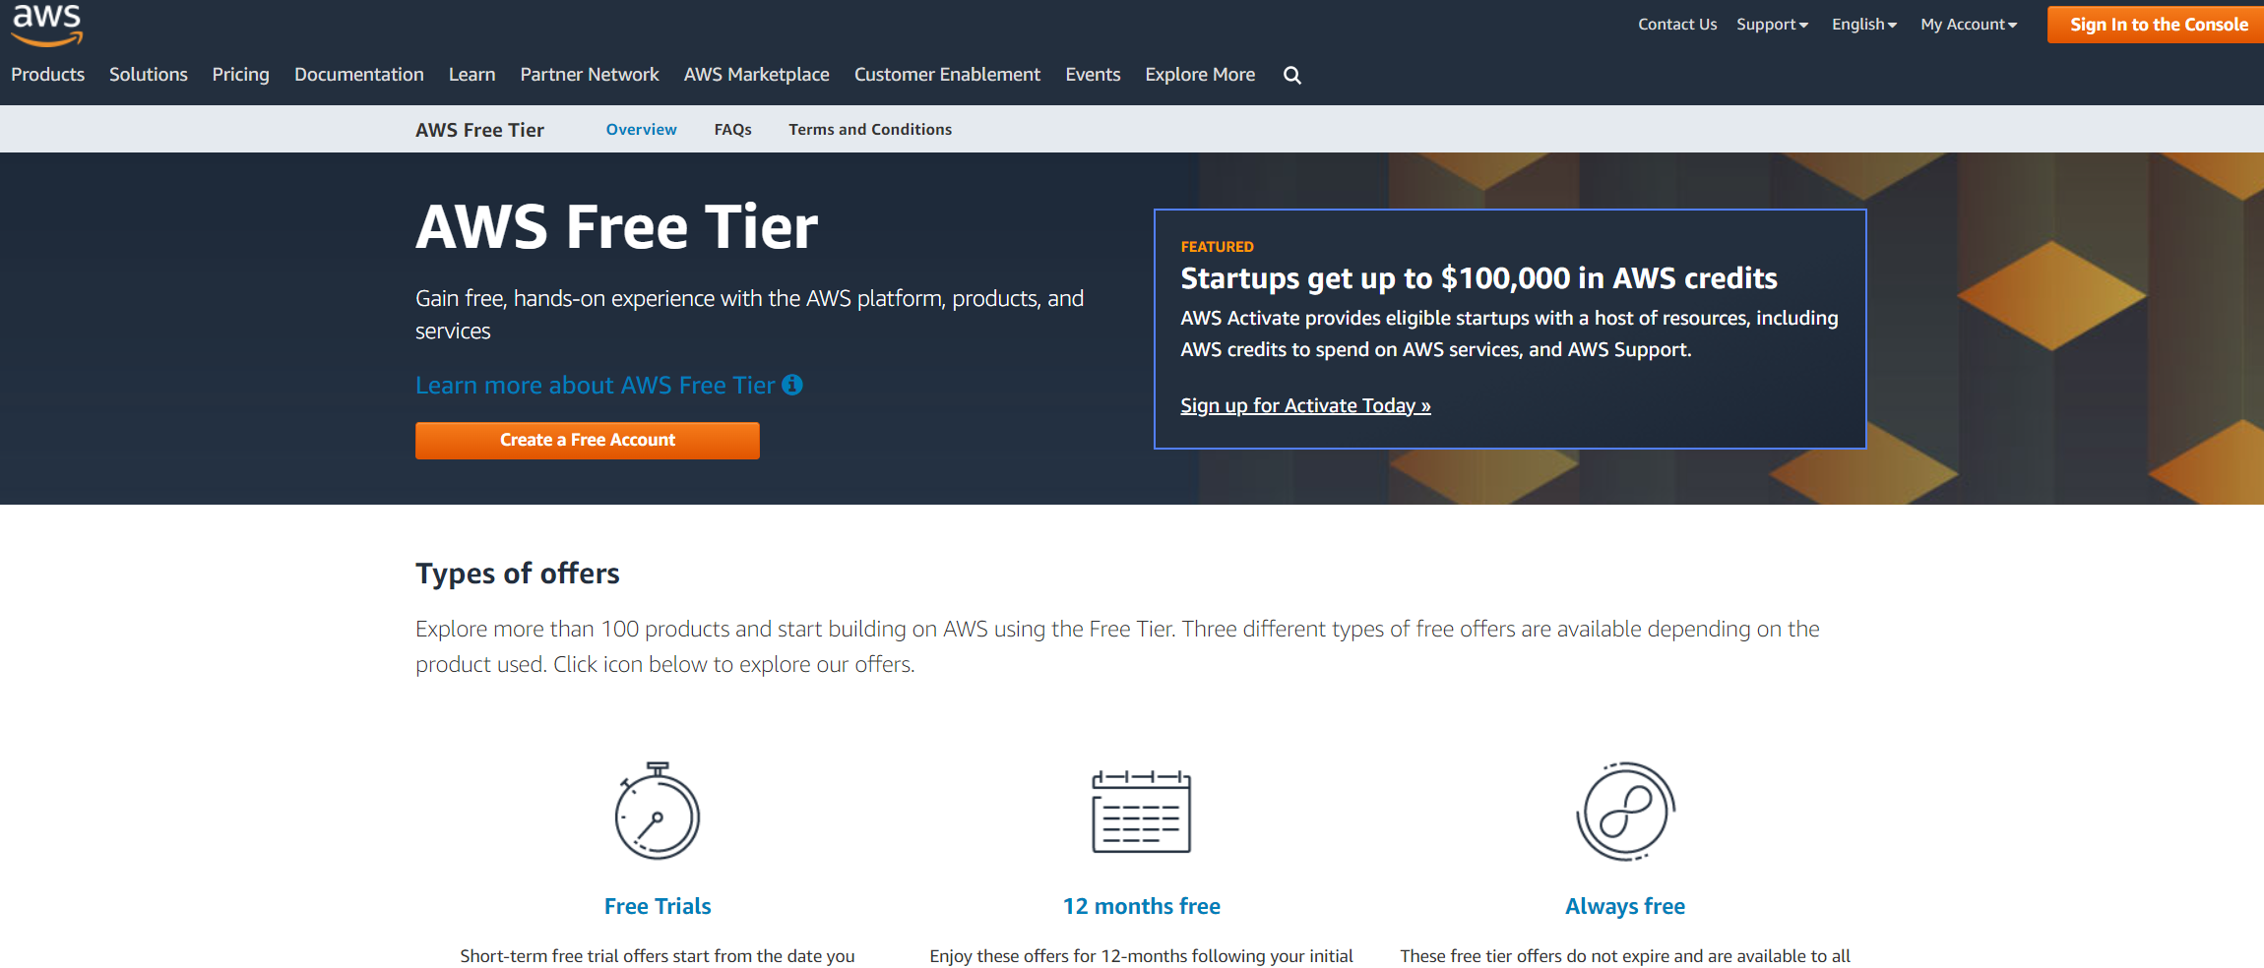
AWS Free Tier

